Slide 1
Flow Decomposition and Transformations
CONTENTS:
Flow Decomposition Algorithms (Section 3.5)
Network Transformation (Section 2.4)
READING ASSIGNMENTS:
Chap 3
Notes:
Get ahold of a network, and use the same network to illustrate the shortest path problem for communication newtorks, the max flow problem, the minimum cost flow problem, and the multicommodity flow problem. This will be a very efficient way of introducing the four problems. (Perhaps under 10 minutes of class time.)

Slide 2
Flow Decomposition and Transformations
Flow Decomposition
Removing Lower Bounds
Removing Upper Bounds
Node splitting
Arc flows: an arc flow x is a vector x satisfying:
  Let b(i) = Σ_{j} x_{ij} - Σ_{i} x_{ji}
    We are not focused on upper and lower bounds on x for now.

Slide 3
Flows along Paths
Usual: represent flows in terms of flows in arcs.
Alternative: represent a flow as the sum of flows in paths and cycles.
Two units of flow in the path P
1
2
2
2
3
2
4
2
5
P
1
1
1
One unit of flow around the cycle C
5
2
1
1
4
1
3
C

Slide 4
Properties of Path Flows
Let P be a directed path.
Let Flow(δ,P) be a flow of δ units in each arc of the path P.
1
2
2
2
3
2
4
2
5
Flow(2, P)
P
Observation. If P is a path from s to t, then Flow(δ,P) sends δ units of flow from s to t, and has conservation of flow at other nodes.

Slide 5
Property of Cycle Flows
If p is a cycle, then sending one unit of flow along p satisfies conservation of flow everywhere.
1
1
1
5
2
1
1
4
1
3

Slide 6
Flows along Paths and Cycles
Let P be a collection of Paths;
let f(P) denote the flow in path P
δ_{ij}(P) = 1 if (i,j) ∈ P
δ_{ij}(P) = 0 if (i,j) ∉ P
Let C be a collection of cycles;
let f(C) denote the flow in cycle C.
δ_{ij}(C) = 1 if (i,j) ∈ C
δ_{ij}(C) = 0 if (i,j) ∉ C

Slide 7
Flows along Paths and Cycles
Claim: one can convert the path and cycle flows into an arc flow x as follows: for each arc (i,j) ∈ A
x_{ij} = Σ_{P ∈ P} δ_{ij}(P)f(P) + Σ_{C ∈ C} δ_{ij}(C)f(C)
We next provide an algorithm for converting arc flows to sums of flows around cycles and along paths,
where each path is from a supply node w.r.t. x to a demand node w.r.t. x.

Slide 8
Flow Decomposition
Notation:
G = (N, A): the network
x: initial flow
y: flow at intermediate stage of the algorithm
A(y) : arcs with positive flow in y
N(y): nodes incident to an arc in A(y)
SupplyNodes(y): nodes with supply w.r.t. y
DemandNodes(y): nodes with demand w.r.t. y
P : paths with flow in the decomposition
C : cycles with flow in the decomposition

Slide 9
Flow Decomposition Algorithm
Initialize
begin
y := x;
P := ∅ ;
C:= ∅;
end
Select(s, y)
begin
if SupplyNodes(y) ≠ ∅,
then s ∈ N(y)
else choose s∈SupplyNodes(y);
end
If there exists deficit nodes, we choose it
o.w. choose a tail node from arcs with y>0
Search(s, y)
Carry out a depth first search starting with node s until finding a directed cycle C in G(y) or a path P in G(y) from s to a node t in DemandNodes(y).

Slide 10
Capacities of Paths and Cycles
8
1
5
The capacity of C is denoted as Δ(C, y) = min arc flow on C w.r.t. flow y.
5
4
9
4
7
7
2
Δ(C) = 4
C
3
-2
Let P be a path from s to t.
The capacity of P is denoted as Δ(P, y) =
min[ b(s), -b(t),
min (x_{ij} : (i,j) ∈ P) ]
s
6
4
4
2
3
9
5
t
P
Δ(P) = 2

Slide 11
The decomposition algorithm
begin
Initialize
while y ≠ ∅ do
begin
Select(s, y)
Search(s, y)
if a cycle C is found then do
begin
let Δ = Capacity(C, y)
Add Flow(Δ, C) to cycle flows
Subtract Flow(Δ, C) from y.
end
if a path P is found then do
begin
let Δ = Capacity(P, y)
Add Flow(Δ, P) to path flows
Subtract Flow(Δ, P) from y.
end
end
end
Flow Decomposition

Slide 12
Complexity Analysis
Select initial node:
  O(1) per path or cycle, assuming that we maintain a set of supply nodes and a set of balanced nodes incident to a positive flow arc
Find cycle or path
  O(n) per path or cycle since finding the next arc in depth first search takes O(1) steps.
Update step
  O(n) per path or cycle

Slide 13
Complexity Analysis (continued)
Lemma. The number of paths and cycles found in the flow decomposition is at most m + n .
Proof. In the update step for a cycle, at least one of the arcs has its capacity reduced to 0, and the arc is eliminated.
In an update step for a path, either an arc is eliminated, or a supply node has its supply reduced to 0, or a demand node has its demand reduced to 0.
(Also, there is never a situation with exactly one node whose supply is non-zero).

Slide 14
Conclusion
Flow Decomposition Theorem. Any non-negative feasible flow x can be decomposed into the following:
the sum of flows in paths directed from supply nodes to demand nodes, plus
the sum of flows around directed cycles.
It will always have at most n + m paths and cycles. (and at most m cycles)
Remark. The decomposition usually is NOT unique.

Slide 15
Corollary
A circulation is a flow with the property that the flow in is the flow out for each node. (i.e. every node is a transshipment node)
Flow Decomposition Theorem for circulations. Any non-negative feasible flow x can be decomposed into the sum of flows around directed cycles.
It will always have at most m cycles.

Slide 16
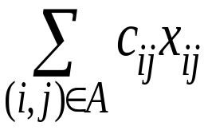
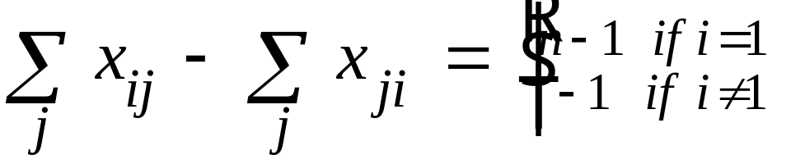
An application of Flow Decomposition
Consider the problem of finding a shortest path from node 1 to all other nodes. Assume that all arc costs are non-negative.
The model:
Minimize
Subject to
Let x* denote the minimum cost flow. Then x* is the sum of flows of paths from node 1 to each other node, plus the sum of flows around cycles.

Slide 17
A shortest path tree
-1
-1
2
4
1
1
5
1
3
1
6
-1
4
3
5
-1
-1
The decomposition of flows yields the paths:
1-2, 1-3, 1-3-4, 1-3-4-5 and 1-3-4-6.
There are no cycles in the decomposition.
Trees have no cycles.

Slide 18
Other Applications of Flow Decomposition
Reformulations of Problems.
  There are network flow models that use path and cycle based formulations.
  Multicommodity Flows
Used in proving theorems
  Negative cycle optimality theorem
  A feasible solution x* of the min-cost network flow problem is optimal iff the residual network G(x*) contains no negative cost directed cycle
Can be used in developing algorithms

Slide 19
Transformations
The minimum cost flow problem
u_{ij} = capacity of arc (i,j).
c_{ij} = unit cost of flow sent on (i,j).
x_{ij} = amount shipped on arc (i,j)
Minimize Σ c_{ij}x_{ij}
Σ_{j} x_{ij} - Σ_{j} x_{ji} = b_{i} for all i ∈ N.
and 0 ≤ x_{ij} ≤ u_{ij} for all (i,j) ∈ A.
If a constraint matrix (ignoring upper bounds) has at most one 1 and at most one -1 in each column, it corresponds to a network flow problem.

Slide 20
Comment on Transformations
Some transformations work directly with the LP formulations (system of equalities and inequalities)
Others work directly on the networks

Slide 21
Eliminating Lower Bound on Arc Flows
Suppose that there is a lower bound l_{ij} on the arc flow in (i,j)
Then let y_{ij} = x_{ij} - l_{ij}. Then x_{ij} = y_{ij} + l_{ij}
Minimize Σ c_{ij}x_{ij}
Σ_{j} x_{ij} - Σ_{j} x_{ji} = b_{i} for all i ∈ N.
and l_{ij} ≤ x_{ij} ≤ u_{ij} for all (i,j) ∈ A.
Minimize Σ c_{ij}(y_{ij} + l_{ij})
Σ_{j} (y_{ij} + l_{ij}) - Σ_{j} (y_{ji} + l_{ji}) = b_{i} for all i ∈ N.
and l_{ij} ≤ (y_{ij} + l_{ij}) ≤ u_{ij} for all (i,j) ∈ A.
Then we can substract l_{ij} and simplify the expressions.

Slide 22
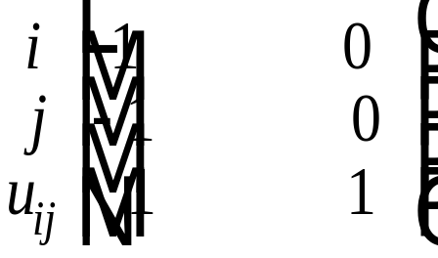
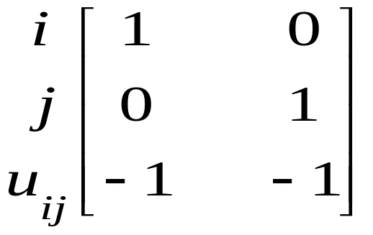
Eliminating Upper Bounds on Arc Flows
The minimum cost flow problem
Min Σ c_{ij}x_{ij}
s.t. Σ_{j} x_{ij} - Σ_{j} x_{ji} = b_{i} for all i ∈ N.
and 0 ≤ x_{ij} ≤ u_{ij} for all (i,j) ∈ A.
c.2=c.2 + c.3
c.3=c.3 x –1
Before
After
x_{ij} s_{ij}
x_{ij} s_{ij}
= b_{i}
= b_{j}
= u_{ij}
= b_{i}
= b_{j} + u_{ij}
= - u_{ij}
i
j
i
<i,j>
j

Slide 23
Node Splitting
2
4
Flow x
2
4
4
1
6
Arc numbers are capacities
5
6
3
5
Suppose that we want to add the constraint that the flow into node 4 is at most 7.
Method: split node 4 into two nodes, say 4’ and 4”
2
7
4’
4”
Flow x’ can be obtained from flow x, and vice versa.
2
4
6
1
5
6
3
5

Slide 24
Summary
Any feasible flow can be decomposed into the sum of flows around cycles plus the sum of flows from nodes with supply to nodes with demand.
Lower bounds that are not 0 can be replaced (via a simple transformation) with lower bounds that are 0.
Each upper bound on an arc can be eliminated, but it is at the expense of creating an additional node.
One can model constraints on flow into or out of a node by splitting the node

